Slide 1
Quantum Symphony
Orchestrating Machine Learning in the Quantum Realm

Slide 2
Roadmap:
Learn the basics about Quantum computing
Learn about basic machine learning and applying it
Learn about deep learning and its application via Pytorch
Implement basic codes relating to Quantum Machine learning in Pennylane
Implement an aspect of QML as given in a research paper

Slide 3
Learning the Basics Quantum Computing and Quantum Information book was used along with the Qiskit Textbook. The summary of this learning was tested in the Assignment 1.
Machine Learning This phase included learning machine learning from the famous Andrew Ng by his courses on Youtube. Pytorch was also included in this phase. After this we moved on to learning about neural networks and reinforcement learning.
Quantum Machine learning In this phase we implemented a gradient descent and a neural network in code and also tested out the basic features of Pennylane. Finally we also read up a few texts on Quantum Machine Learning.

Slide 4
The Final Project: Data Reuploading
The project aims to understand and implement a research paper which explores a quantum classifier built using only a single qubit.
The resulting quantum classifier is actually a hybrid one. It uses the qubit to store the states while the classical computers and algorithms to implement the neural network.
The data is encoded on the qubit with the help of the rotations. These rotations have as their values the parameters of the network and the data alternatively.
This helps introduce non-linearity into the data and thus allow the classifier to work on complex datasets.

Slide 5
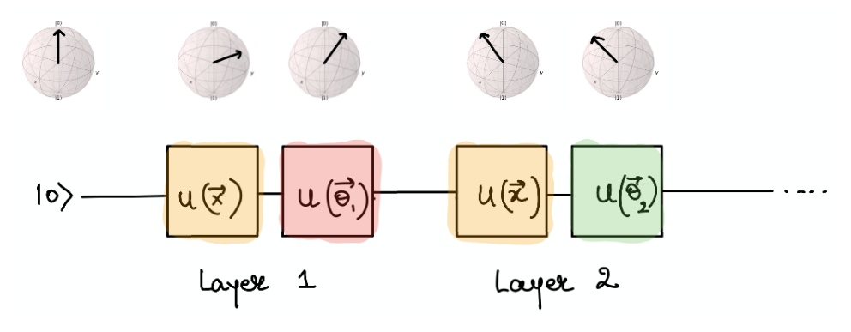
Here we show how the layer of the classifier have been designed.
Each layer includes a parameter operator and a data operator for rotation.
After the final state the cost is estimated using standard fidelity formula and thus the classical algorithm takes over.

Slide 6
Simplifications
The code uses only a two-dimensional dataset. This is not necessary as the paper suggests breaking up the dimensions and implementing them in separate layers with appropriate repetition to avoid limiting the dimensions to 3.
We also simplify the parameters to have values in terms of the rotations. This makes implementation easier. The research paper though, has accounted for combining the two rotations of a layer into one and visualising the parameters as weights which act on the dataset.
We have also used the Adam optimizer for the neural network instead of the L-BGFS used in the research paper.

Slide 7
Sources
https://pennylane.ai/qml/demos/tutorial_data_reuploading_classifier/
https://arxiv.org/pdf/1907.02085
https://github.com/adityasingh1729/Quantum-Symphony/tree/main

